Slide 1
Final Review
INFO 4220 – Networks II: Market Design

Slide 2
Format of this review
I will go quickly over the key concepts
  If anything of what I say today sounds unfamiliar, you should review the relevant lecture
  For the things covered before prelim 2, I will go very fast

Slide 3
What Was This Course About
Market Design:
Who is going to get what
At what price (if there is a price)
Will agents be “ok” with the mechanism/outcome
  How are they going to behave before and after the transaction
Is the mechanism strategy proof
Is the allocation stable/efficient
Networked Markets:
What if there is a feedback loop between the two sides in the transaction

Slide 4
Topics Covered
Matching and assignment problems
Auctions
  Basic types: First price and second price
  VCG Auction
  Generalized Second Price & Generalized English Auctions
  Auctions in online settings and online advertising
  Spectrum auctions: Combinatorial auctions (multi-unit)
  Auctions in Financial Markets

Slide 5
One-to-One Matching
Musician-singer matching problem
We wanted to find “stable” matchings:
  Individual rationality
  No blocking pairs
To find stable matchings we used the deferred acceptance algorithm
  Strategy-proof for the proposing side
  Optimality: Gives the most preferred stable matching for the side that is proposing
  Impossible to have strategy proofness for both sides and stability (in general)

Slide 6
Many-to-one Matching
Hospital-resident matching problem
Need to introduce a way of expressing preferences over sets: We used responsive preferences
Need to add an additional requirement for stability: Non-wastefulness
A modified DA algorithm can be used to find stable matchings:
  Strategy-proof for doctors when they propose, not strategy-proof for hospitals
We talked about real world implications: Importance of using a stable mechanism, the rural hospital problem, and the issue with matching couples

Slide 7
Assignment Problems
In assignment problems we assign objects to individuals:
  Individuals have preferences over objects
  Individuals may own objects that they can keep or trade (endowments)
  Individuals may have a priority to get an object
  Objects don’t have preferences
  We use efficiency to evaluate assignments
3 types of problems:
  Public endowment: No one owns an object
  Private endowment: Everyone has an object
  Mixed endowment: Some people have an object, some don’t

Slide 8
Serial Dictatorship
Simple mechanism and when used in problems without endowments is:
  Efficient
  Strategyproof
  Individually rational
Can also be used in problems with endowments:
  Still strategyproof
  Still efficient
  But someone could end up with an object they like less than their initial endowment. Thus, not individually rational

Slide 9
Top Trading Cycle
When there are endowments or priorities, TTC algorithm helps us find efficient assignments
Algorithm that allows agents to trade objects:
  Efficient
  Strategyproof
  Has the advantage over serial dictatorship of also being individually rational
Theorem: An assignment mechanism is strategyproof, efficient, and individually rational iff it uses the top trading cycle algorithm
Core: You can’t find a coalition that wants to split and trade between themselves to be better off

Slide 10
Mixed Public-Private Endowments
Typical example: Dorm room allocation
Random serial dictatorship with squatting rights: Not individually rational nor efficient
Random serial dictatorship with waiting lists: Not efficient
MIT-NH4: Still not efficient
Mechanisms that are strategy proof and finds efficient and individually rational assignments
  TTC w/ mixed endowments and YRMH-IGYT

Slide 11
Probabilistic Assignments
It is useful to sometimes add randomness to mechanisms to increase fairness
With probabilistic assignments we need to distinguish between ex-ante and ex-post efficiency
  Ex-ante: We compare the odds individuals get under different assignments (stochastic dominance)
  Ex-post: We look if the different assignments that could result are efficient or not
Random serial dictatorships or TTC w/random endowments are not ex-ante efficient
To achieve ex-ante efficiency: Use eating algorithms

Slide 12
School Assignments
Like many-to-one assignments, but we add that schools may have priority lists
We need to consider stability again. We need:
  Individual rationality
  Non-wastefulness
  No justified envy
We evaluate efficiency using students’ preferences
DA: Gives you stable assignments
TTC: Gives you efficient assignments
In general stability and efficiency are incompatible
We talk about the cases of Boston and NYC
We talked about the problem of weak priorities, tie-breaking rules, and improvement cycles

Slide 13
Course Allocation
This is a many-to-many assignment problem. A lot more complicated:
  No obvious choice of algorithms. Before we could have an algorithm that was either: strategyproof, efficient, or stable
  Combinatorial assignment problem: Many possible assignments possible
  Moreover, some courses are complements, while other are substitutes: We cannot really use responsive preferences
To choose algorithms in this context we introduced a new definition: Non-bossy assignment

Slide 14
Serial Dictatorship in Course Assignment
Non-bossy means that nobody can change other individuals’ assignment without changing their own assignment
Theorem (Pápai):
A many-to-many assignment mechanism is strategyproof, non-bossy, and pareto efficient if, and only if, it is a serial dictatorship mechanism

Slide 15
Course Allocation in Practice
Many universities use a bidding system:
  Not strategy-proof, and bids do not reflect the true “prices” of courses
A better solution than bidding is using deferred acceptance with bidding
HBS draft mechanism:
  Students engage in strategic behavior
  It may not be strategyproof or efficient, but in practice works better than a random serial dictatorship (with student picking full schedules during their turn)

Slide 16
Course Allocation in Practice
The Wharton School uses the “Approximate Competitive Equilibrium with Equal Incomes”
Students submit bids over “schedules”
  Not really, as considering all schedules would be impossible
  Students submit bids, and adjustment for combinations of courses
They only look for an “approximate” equilibrium
Outcomes produced by this algorithm are preferred by students (compared to traditional bidding mechanism)

Slide 17
Kidney Exchange
Some people want to donate a kidney to a loved one, but they are incompatible
  To donate a kidney you need blood type and tissue compatibility
They can do an “exchange” with someone else that also wants to donate to someone else and is facing compatibility issues. How do we coordinate these exchanges?
We also need to coordinate with the donations from cadaveric donors

Slide 18
Kidney Exchange
Not as simple as giving a patient that brings in a donor priority in the waiting list:
  Some blood/tissue types are more rare than others, also some are more compatible than others
We need a system that is fair and stable:
  List based exchanges
  Paired kidney exchange: Top trading cycle and chains
TTC with chains depend on chain selection rules
  Some chain selection rules are efficient
  Some chain selection rules are strategyproof
  Some chain selection rules lead to “desirable” outcomes

Slide 19
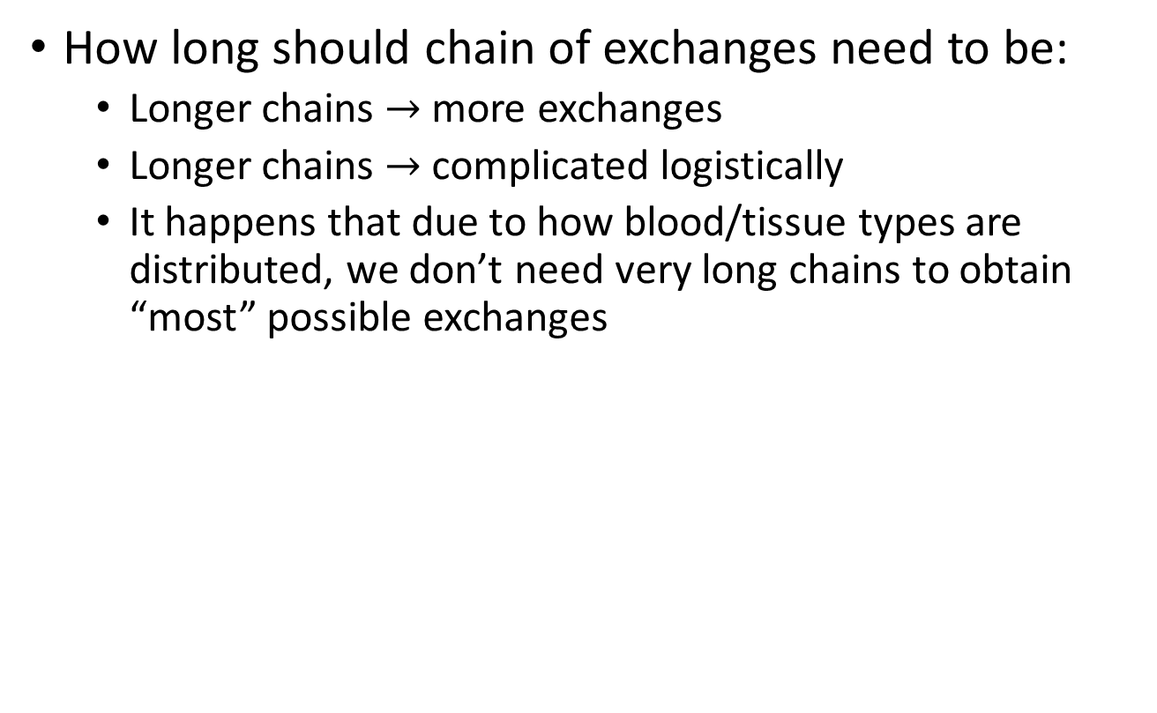
Kidney Exchange
How long should chain of exchanges need to be:
  Longer chains $→$ more exchanges
  Longer chains $→$ complicated logistically
  It happens that due to how blood/tissue types are distributed, we don’t need very long chains to obtain “most” possible exchanges

Slide 20
Game Theory Recap
We first talked about Normal Form Games
  Players are rational, know the structure of the game, the rules, and they payoffs of the game
  All the players choose their actions at the same time
(Strict) Dominant actions: The action that maximizes a payer’s profits no matter what all the others players are playing
  Eq. in dominant actions: If all players have one
Nash Equilibrium: An outcome in which no player would benefit from changing their action, provided that all other players do not deviate from their actions

Slide 21
Game Theory Recap
Then we talked about extensive form games:
  Actions are now taken sequentially
  As game progresses, some information is revealed
We examine the normal form representation (of extensive form games):
  A strategy in this form consists on specifying an action at each node where the player may take a decision
  Then we say why N.E. in these games are not as useful
Finally, we introduced the concept of subgame perfect equilibria (SPE)
  An outcome is a SPE if it induces a N.E. in every subgame of the original game
  An we find them by using backward induction

Slide 22
Auctions
Type of market mechanism that uses prices to determine allocations
And also, a price discovery mechanism
There are many different types of auction that differ on:
  What constitutes a bid
  How bids are placed
  How price and quantities are allocated
Bidders have valuations: They can be either private or common

Slide 23
Bidding Behavior and Efficiency
Bidders are not necessarily going to bid their valuations
An auction is efficient when:
  Winner is the bidder with the highest valuation
  Efficiency leads to revenue maximization
Two families of auctions types:
  Ascending price auctions
  Descending price auctions

Slide 24
Ascending Auctions
English Outcry Auction: Bidders announce their prices, pay their bids
English Auction: Auctioneer announce prices, bidders accept/decline the price. Price is last price announced
Japanese Button: Price displayed on a screen, bidders push button to remain in the auction. Last bidder standing gets item at last price
The English Auction is Strategyproof
These all look similar, but they have some differences that have behavioral implications

Slide 25
Vickrey Auction
The Vickrey auction is a simultaneous, 2nd price auction (also called 2nd price sealed bid auction):
  Buyers submit a sealed-bid
  The winner is the one with the highest bid
  The winner pays the 2nd highest price
  (The ticking price disappears because there are no dynamics)
Proposition:
In the Vickrey auction, truthful bidding is a dominant strategy (i.e. it is strategyproof)

Slide 26
Bidding Strategy
In second price auctions, bidding strategy is straightforward: Bid your valuation
English auctions may look like first-price auctions, but they are closer to second price auctions
In first price auctions is more complicated:
  Strategic game: You need to determine how much to bid based on what you know of your valuation and the valuations of others

Slide 27
Descending/Dutch Auctions
Price clock displays a decreasing price
Auction stops when someone claims the object
Strategically equivalent to a first-price sealed-bid auction
Advantages:
  Goes very fast
  Uses bidders’ nervousness to make the bid higher than they should (fear of missing out)

Slide 28
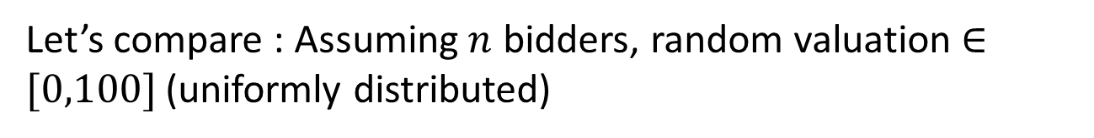
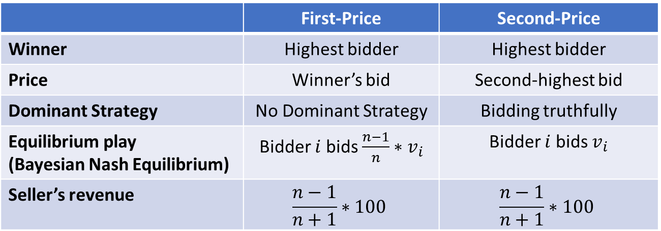
Second-price (English) vs First-price (Dutch) auctions
Let’s compare : Assuming $n$ bidders, random valuation $∈[0,100]$ (uniformly distributed)
 | First-Price | Second-Price
Winner | Highest bidder | Highest bidder
Price | Winner’s bid | Second-highest bid
Dominant Strategy | No Dominant Strategy | Bidding truthfully
Equilibrium play (Bayesian Nash Equilibrium) | Bidder $i$ bids $\frac{n−1}{n}∗v_{i}$ | Bidder $i$ bids $v_{i}$
Seller’s revenue | $$\frac{n−1}{n+1}∗100$$ | $$\frac{n−1}{n+1}∗100$$
Then we talked more generally about revenue equivalence theorem

Slide 29
Reserve Price and Optimal Auction Format
The problem of the auctioneer is to choose an auction format that will maximize revenue
In some cases, specially when there are few bidders, auctions can produce very bad prices
A solution is to use a reserve price
However, reserve price introduce a tradeoff:
  Higher revenue if item sells
  Lower probability of the item selling
It is possible to find an optimal reserve price*. The optimal auction is a Vickrey auction with this reserve price
But a second price auction with more bidders yield better results than the optimal mechanism
* Under certain assumptions

Slide 30
eBay
We looked at how eBay implemented auctions online and how it maps to the different auctions we had seen
  Proxy bidding is equivalent to second price auctions
We then looked at a study that analyzes how bidders actually behave:
  Bid sniping
  Incremental bidding
Study also compared what happens in eBay to what happened with Amazon (now defunct) auction system
  Amazon’s implementation attempted to reduce bid sniping
Evidence shows: Auction design influences behavior

Slide 31
VCG Auction
Mechanism to auction multiple items at the same time
Typically buyers want “combinations” of items
VCG allows bidders to express preferences over sets of items:
  Each bidder submits her bid function
  Assignment is the one that maximizes social value
  Bidders pay the externality that they impose on others
VCG with one objects is just a Vickrey auction
VCG auction is strategyproof, but is also hard to use because it is an NP complete problem

Slide 32
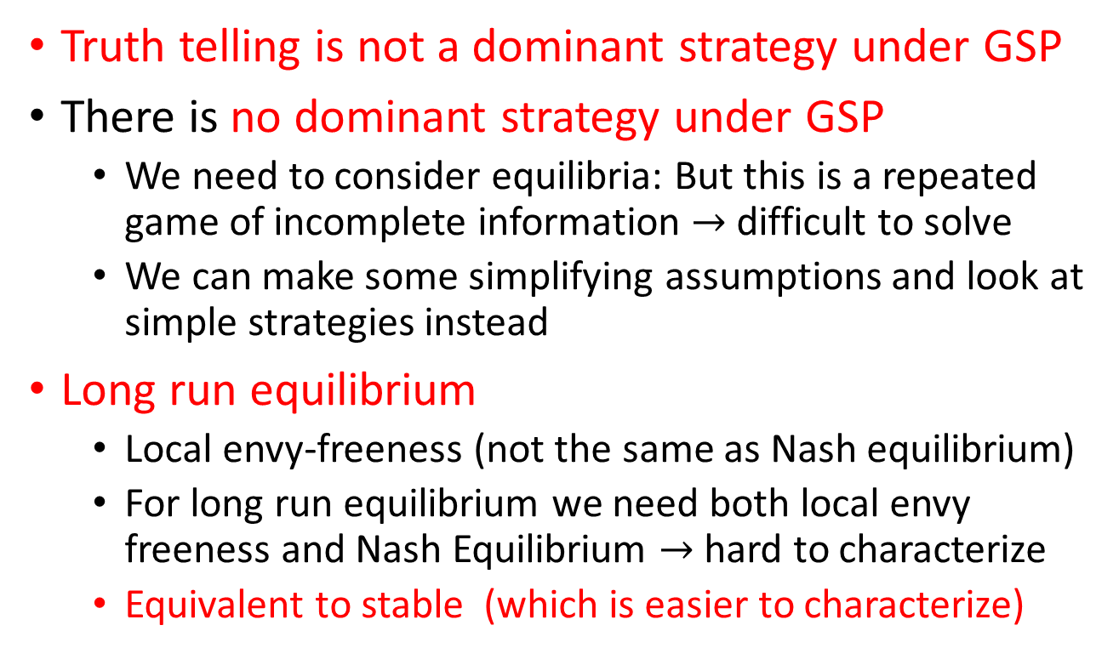
GSP Properties
Truth telling is not a dominant strategy under GSP
There is no dominant strategy under GSP
  We need to consider equilibria: But this is a repeated game of incomplete information $→$ difficult to solve
  We can make some simplifying assumptions and look at simple strategies instead
Long run equilibrium
  Local envy-freeness (not the same as Nash equilibrium)
  For long run equilibrium we need both local envy freeness and Nash Equilibrium $→$ hard to characterize
  Equivalent to stable (which is easier to characterize)

Slide 33
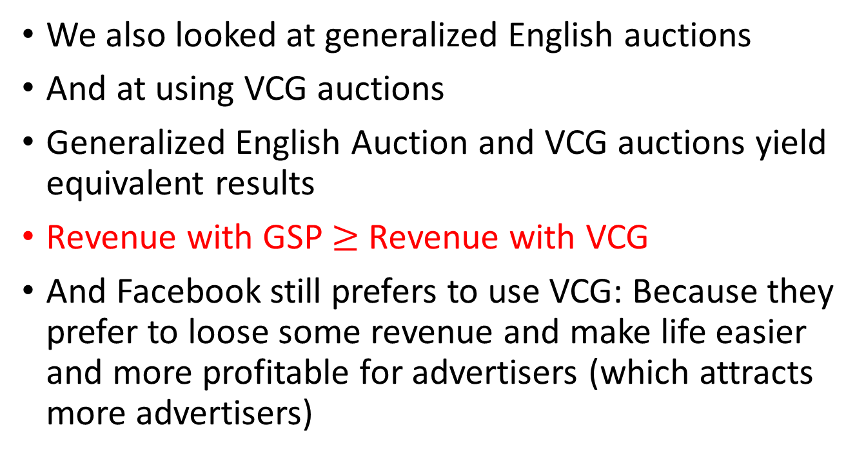
Other ways of running online auctions
We also looked at generalized English auctions
And at using VCG auctions
Generalized English Auction and VCG auctions yield equivalent results
Revenue with GSP $≥$ Revenue with VCG
And Facebook still prefers to use VCG: Because they prefer to loose some revenue and make life easier and more profitable for advertisers (which attracts more advertisers)

Slide 34
Financial Markets
Financial markets extensively rely on auctions
A simple example are the treasury auctions:
  It is a particular case of double auction: Treasury is the buyer (buying cash), and the investors are the sellers
  It is also a uniform price auction: All bidders are awarded the same yield rate
In financial markets most auctions are double auctions:
  Seller submits asks (lower price she is willing to accept)
    Could be limit or market order
  Buyers submit bids (higher price she is willing to pay)
    Could be limit or market order
  Then bids and asks are balanced in a way similar to market equilibrium

Slide 35
Thank you
I hope you liked the course and learned something useful!

